Slide 1
CHAPTER Production
9 Functions

Slide 2
Marginal Productivity
The firm’s production function
  For a particular good (q)
  Shows the maximum amount of the good that can be produced
  Using alternative combinations of capital (k) and labor (l)
q = f(k,l)

Slide 3
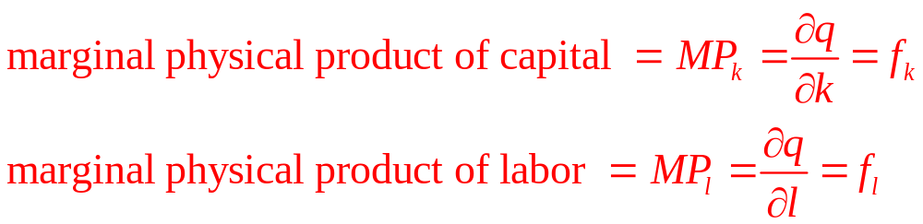
Marginal Physical Product
Marginal physical product
  The additional output that can be produced
  By employing one more unit of that input
  Holding other inputs constant

Slide 4
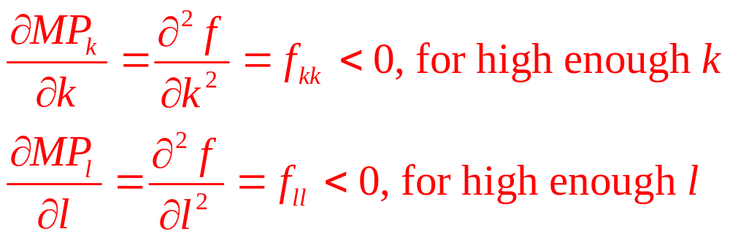
Diminishing Marginal Productivity
Marginal physical product
  Depends on how much of that input is used
Diminishing marginal productivity

Slide 5
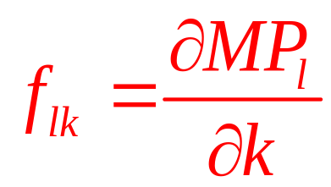
Diminishing Marginal Productivity
Changes in the marginal productivity of labor
  Also depend on changes in other inputs such as capital
  We need to consider f_{lk} which is often > 0

Slide 6
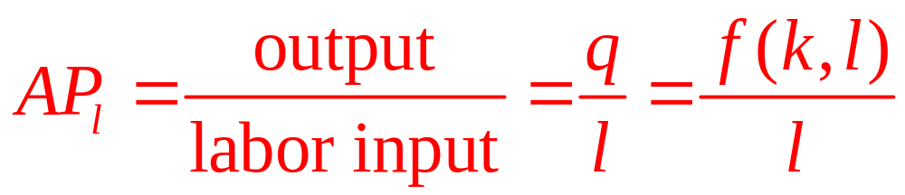
Average Physical Product
Labor productivity
  Often means average productivity
Average product of labor
  AP_{l} also depends on the amount of capital employed

Slide 7
9.1 A Two-Input Production Function
Suppose the production function for flyswatters can be represented by
q = f(k,l) = 600k ²l² - k ³l³
To construct MP_{l} and AP_{l}, we must assume a value for k
  Let k = 10
The production function becomes
q = 60,000l² - 1000l³

Slide 8
9.1 A Two-Input Production Function
The marginal productivity function is
MP_{l} = ∂q/∂l = 120,000l - 3000l²
  Which diminishes as l increases
  This implies that q has a maximum value:
120,000l - 3000l² = 0
40l = l²
l = 40
Labor input beyond l = 40 reduces output

Slide 9
9.1 A Two-Input Production Function
To find average productivity, we hold k=10 and solve
AP_{l} = q/l = 60,000l - 1000l²
AP_{l} reaches its maximum where
∂AP_{l}/∂l = 60,000 - 2000l = 0
l = 30
When l = 30, AP_{l} = MP_{l} = 900,000
  When AP_{l} is at its maximum, AP_{l} and MP_{l} are equal

Slide 10
Isoquant Maps
Isoquant map
  To illustrate the possible substitution of one input for another
An isoquant
  Shows those combinations of k and l that can produce a given level of output (q₀)
f(k,l) = q₀

Slide 11
9.1 An Isoquant Map
k per period
A
q = 30
k_{A}
B
q = 20
k_{B}
q = 10
l_{A}
l_{B}
l per period
Isoquants record the alternative combinations of inputs that can be used to produce a given level of output. The slope of these curves shows the rate at which l can be substituted for k while keeping output constant. The negative of this slope is called the (marginal) rate of technical substitution (RTS). In the figure, the RTS is positive and diminishing for increasing inputs of labor.

Slide 12
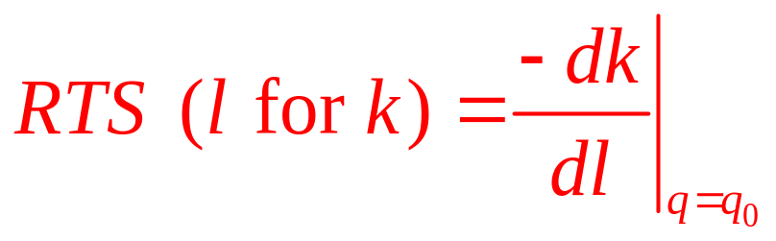
Marginal Rate of Technical Substitution
Marginal rate of technical substitution (RTS)
  Shows the rate at which labor can be substituted for capital
  Holding output constant along an isoquant

Slide 13
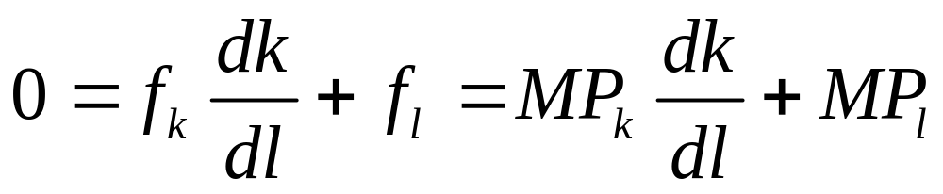
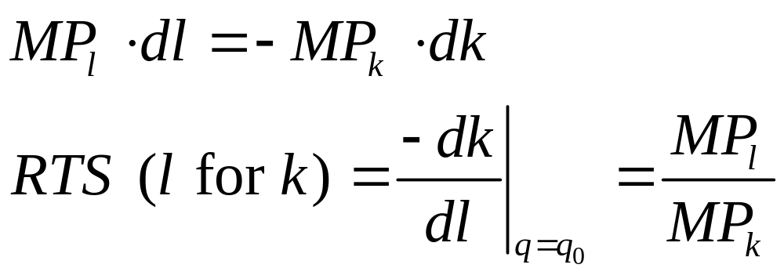
RTS and Marginal Productivities
Total differential of the production function
q₀ = f(k(l),l), with q₀ constant
RTS is given by the ratio of the inputs’ marginal productivity

Slide 14
RTS and Marginal Productivities
RTS will be positive (or zero)
  Because MP_{l} and MP_{k} will both be nonnegative
Not possible to derive a diminishing RTS
  From the assumption of diminishing marginal productivity alone
To show that isoquants are convex
  Show that d(RTS)/dl < 0

Slide 15
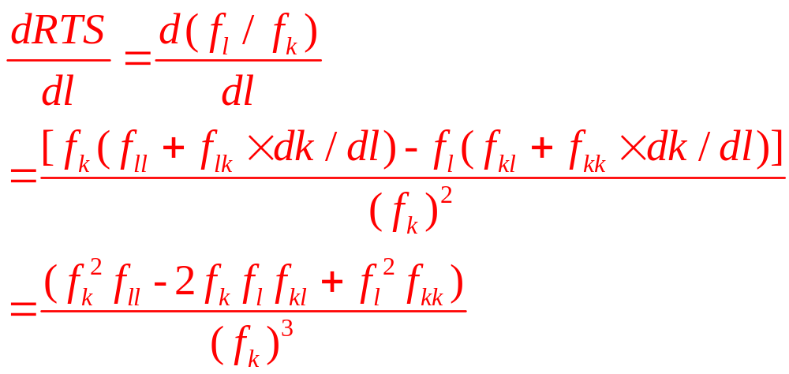
RTS and Marginal Productivities
Since RTS = f_{l}/f_{k}
  And dk/dl = -f_{l}/f_{k} along an isoquant and Young’s theorem (f_{kl} = f_{lk})

Slide 16
RTS and Marginal Productivities
Denominator is positive
  Because we have assumed f_{k} > 0
The ratio will be negative if f_{kl} is positive
  Because f_{ll} and f_{kk} are both assumed to be negative
Intuitively, it seems reasonable that f_{kl} = f_{lk} should be positive
  If workers have more capital, they will be more productive

Slide 17
RTS and Marginal Productivities
But some production functions have f_{kl} < 0 over some input ranges
  Assuming diminishing RTS means that MP_{l} and MP_{k} diminish quickly enough to compensate for any possible negative cross-productivity effects

Slide 18
9.2 A Diminishing RTS
Production function:
q = f(k,l) = 600k ²l ² - k ³l ³
Marginal productivity functions:
MP_{l} = f_{l} = 1200k ²l - 3k ³l ²
MP_{k} = f_{k} = 1200kl ² - 3k ²l ³
  Will be positive for values of k and l for which
  kl < 400

Slide 19
9.2 A Diminishing RTS
Because
f_{ll} = 1200k ² - 6k ³l and f_{kk} = 1200l ² - 6kl ³
  Diminishing marginal productivities for sufficiently large values of k and l
  f_{ll} and f_{kk} < 0 if kl > 200
Cross differentiation of either of the marginal productivity functions yields
f_{kl} = f_{lk} = 2400kl - 9k ²l ²
  Which is positive only for kl < 266

Slide 20
Returns to Scale
How does output respond to increases in all inputs together?
  Suppose that all inputs are doubled, would output double?
As inputs are doubled
  Greater division of labor and specialization of function
  Loss in efficiency - management may become more difficult

Slide 21
Returns to Scale
Production function is given by q = f(k,l)
  And all inputs are multiplied by the same positive constant (t >1)
  Then we classify the returns to scale of the production function by
Effect on Output | Returns to Scale
f(tk,tl) = tf(k,l) = tq | Constant
f(tk,tl) < tf(k,l) = tq | Decreasing
f(tk,tl) > tf(k,l) = tq | Increasing

Slide 22
Returns to Scale
Production function
  Constant returns to scale for some levels of input usage
  Increasing or decreasing returns for other levels
  The degree of returns to scale is generally defined within a fairly narrow range of variation in input usage

Slide 23
Constant Returns to Scale
Constant returns-to-scale production functions
  Are homogeneous of degree one in inputs
f(tk,tl) = t¹f(k,l) = tq
The marginal productivity functions
  Are homogeneous of degree zero
  If a function is homogeneous of degree k, its derivatives are homogeneous of degree k-1

Slide 24
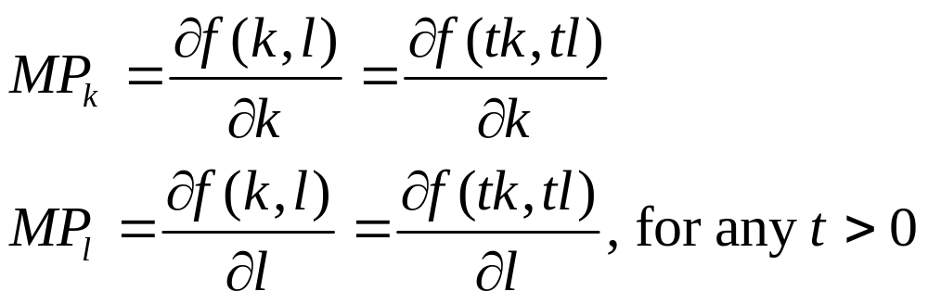
Constant Returns to Scale
The marginal productivity functions
  Derived from a constant returns to scale production function
  Are homogeneous of degree 0

Slide 25
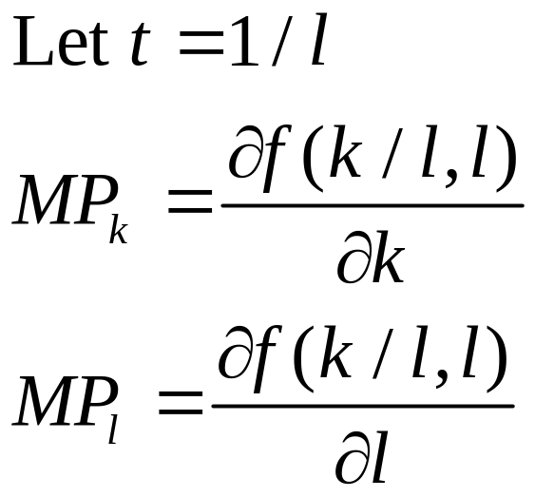
Constant Returns to Scale
Marginal productivity of any input
  Depends on the ratio of capital and labor
  Not on the absolute levels of these inputs

Slide 26
9.2 Isoquant Map for a Constant
Returns-to-Scale Production Function
k per period
q = 3
q = 2
q = 1
l per period
Because a constant returns-to-scale production function is homothetic, the RTS depends only on the ratio of k to l, not on the scale of production. Consequently, along any ray through the origin (a ray of constant k/l), the RTS will be the same on all isoquants. An additional feature is that the isoquant labels increase proportionately with the inputs.

Slide 27
Homothetic Production Functions
The RTS between k and l
  Depends only on the ratio of k to l
  Not the scale of operation
  Homothetic production function
    All of the isoquants are radial expansions of one another

Slide 28
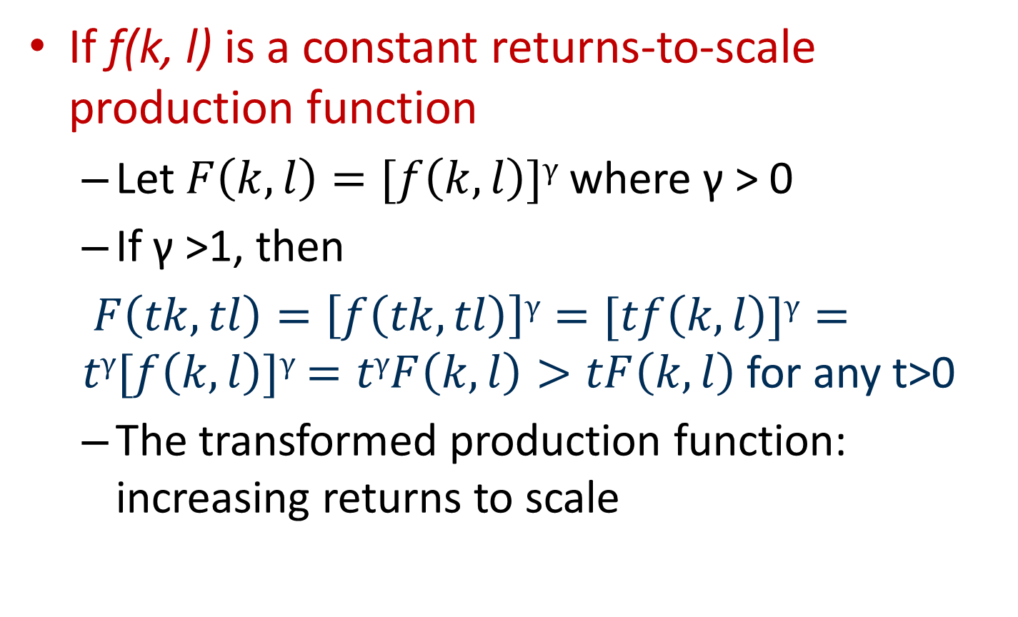
Homothetic Production Functions
If f(k, l) is a constant returns-to-scale production function
  Let $F\left(k,l\right)=[f\left(k,l\right)]γ$ where γ > 0
  If γ >1, then
  $F\left(tk,tl\right)=\left[f\left(tk,tl\right)\right]γ=[tf\left(k,l\right)]γ=tγ[f\left(k,l\right)]γ$ $=tγF\left(k,l\right)>tF\left(k,l\right)$ for any t>0
  The transformed production function: increasing returns to scale

Slide 29
The n-input case
Returns to scale can be generalized to a production function with n inputs
q = f(x₁,x₂,…,x_{n})
  If all inputs are multiplied by a positive constant t:
f(tx₁,tx₂,…,tx_{n}) = t^{k}f(x₁,x₂,…,x_{n})=t^{k}q
    If k = 1, constant returns to scale
    If k < 1, decreasing returns to scale
    If k > 1, increasing returns to scale

Slide 30
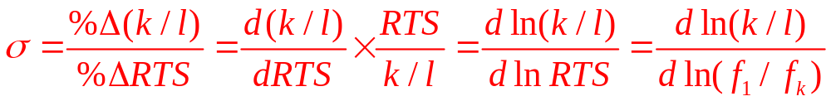
The Elasticity of Substitution
Elasticity of substitution (σ)
  For the production function q = f (k, l)
  Measures the proportionate change in k/l relative to the proportionate change in the RTS along an isoquant
  The value of σ will always be positive because k/l and RTS move in the same direction

Slide 31
9.3 Graphic Description of the Elasticity of
Substitution
k per period
RTS_{A}
A
RTS_{B}
(k/l)_{A}
B
q₀
(k/l)_{B}
l per period
In moving from point A to point B on the q₀ isoquant, both the capital–labor ratio (k/l) and the RTS will change. The elasticity of substitution (σ) is defined to be the ratio of these proportional changes; it is a measure of how curved the isoquant is.

Slide 32
Elasticity of Substitution
If σ is high
  The RTS will not change much relative to k/l
  The isoquant will be relatively flat
If σ is low
  The RTS will change by a substantial amount as k/l changes
  The isoquant will be sharply curved
σ can change along an isoquant
  Or as the scale of production changes

Slide 33
Elasticity of Substitution
Elasticity of substitution between two inputs
  The proportionate change in the ratio of the two inputs
  To the proportionate change in RTS
  With output and the levels of other inputs constant

Slide 34
The Linear Production Function
Linear production function (σ = ∞):
q = f(k,l) = αk + βl
  Constant returns to scale for t>1
f(tk,tl) = α tk + β tl = t(α k + β l) = tf(k,l)
  All isoquants are straight lines with slope --α/β
    RTS is constant
    σ = ∞

Slide 35
9.4 (a) Isoquant Maps for Simple Production Functions with Various Values for σ
(a) σ = ∞
k per period
slope = - β/α
q₁
q₂
q₃
l per period
Three possible values for the elasticity of substitution are illustrated in these figures.
In (a), capital and labor are perfect substitutes. In this case, the RTS will not change as the capital–labor ratio changes.

Slide 36
Fixed Proportions
Fixed proportions production function
(σ = 0):
q = min (αk,βl) α, β > 0
  Capital and labor must always be used in a fixed ratio
    The firm will always operate along a ray where k/l is constant
  Because k/l is constant, σ = 0

Slide 37
9.4 (b) Isoquant Maps for Simple Production
Functions with Various Values for σ
(b) σ = 0
k per period
q₃/α
q₃
q₂
q₁
q₃/β
l per period
Three possible values for the elasticity of substitution are illustrated in these figures.
In (b), the fixed–proportions case, no substitution is possible. The capital–labor ratio is fixed at β/α.

Slide 38
Cobb-Douglas Production Function
Cobb-Douglas production function (σ = 1):
q = f(k,l) = Ak^{α}l^{β} A,α,β > 0
This production function can exhibit any returns to scale
f(tk,tl) = A(tk) ^{α}(tl) ^{β} = At ^{α + β} k ^{α} l ^{β} = t ^{α + β} f(k,l)
  if α +β = 1 ⇒ constant returns to scale
  if α +β > 1 ⇒ increasing returns to scale
  if α +β < 1 ⇒ decreasing returns to scale

Slide 39
Cobb-Douglas Production Function
The Cobb-Douglas production function is linear in logarithms:
ln q = ln A + α ln k + β ln l
  α is the elasticity of output with respect to k
  β is the elasticity of output with respect to l

Slide 40
9.4 (c) Isoquant Maps for Simple Production
Functions with Various Values for σ
(c) σ = 1
k per period
q = 3
q = 2
q = 1
l per period
Three possible values for the elasticity of substitution are illustrated in these figures.
A case of intermediate substitutability is illustrated in (c).

Slide 41
CES Production Function
CES production function (σ = 1/(1-ρ)):
q = f(k,l) = [k^{ρ} + l^{ρ}] ^{γ/ρ} ρ ≤ 1, ρ ≠ 0, γ > 0
  γ > 1 ⇒ increasing returns to scale
  γ < 1 ⇒ decreasing returns to scale
  For this production function, σ = 1/(1-ρ)
    ρ = 1 ⇒ linear production function
    ρ = -∞ ⇒ fixed proportions production function
    ρ = 0 ⇒ Cobb-Douglas production function

Slide 42
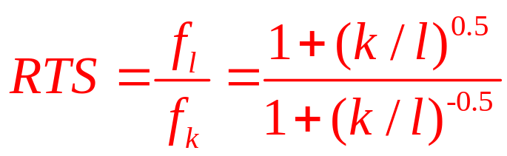
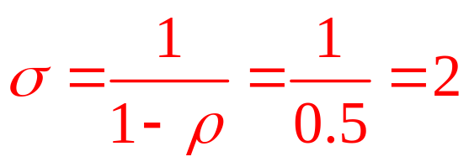
9.3 A Generalized Leontief Production Function
Production function: q = f(k,l) = k + l + 2(kl)^{0.5}
  Constant returns to scale
  Marginal productivities are
f_{k} = 1 + (k/l)^{-0.5} and f_{l} = 1 + (k/l)^{0.5}
  RTS diminishes as k/l falls
  This function has a CES form (ρ = 0.5 and γ = 1)
  Elasticity of substitution:

Slide 43
Technical Progress
Methods of production change over time
  Following the development of superior production techniques
    The same level of output can be produced with fewer inputs
    The isoquant shifts inward

Slide 44
9.5 Technical Progress
k per period
k₂
k₁
IQ’
IQ”
l₁
l₂
l per period
Technical progress shifts the q₀ isoquant, labeled IQ’, toward the origin. The new q₀ isoquant, IQ”, shows that a given level of output can now be produced with less input. For example, with k₁ units of capital it now only takes l₁ units of labor to produce q₀, whereas before the technical advance it took l₂ units of labor.

Slide 45
Measuring Technical Progress
Production function: q = A(t)f(k,l)
  Where A(t) represents all influences that go into determining q other than k and l
  Changes in A over time represent technical progress
    A is shown as a function of time (t)
    dA/dt > 0

Slide 46
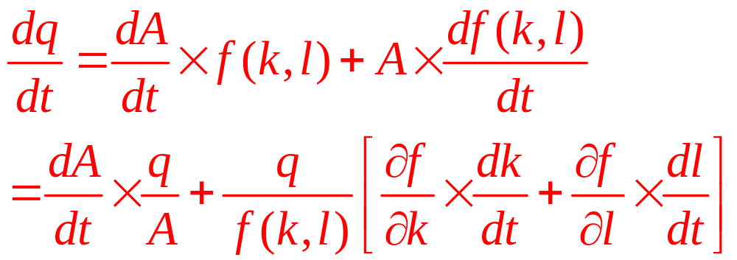
Measuring Technical Progress
Differentiating the production function with respect to time we get

Slide 47
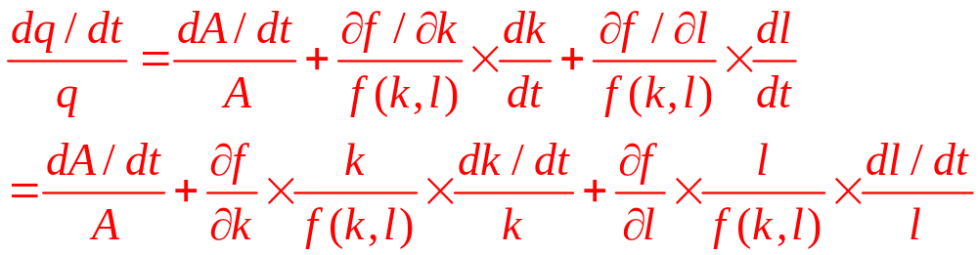
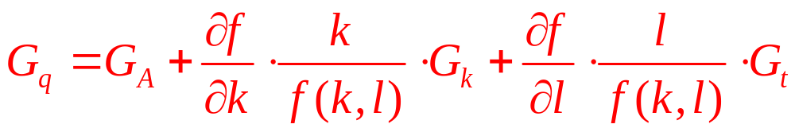
Measuring Technical Progress
Dividing by q gives us
  G_{x} - proportional growth rate in x, [(dx/dt)/x]
  Write the equation in terms of growth rate

Slide 48
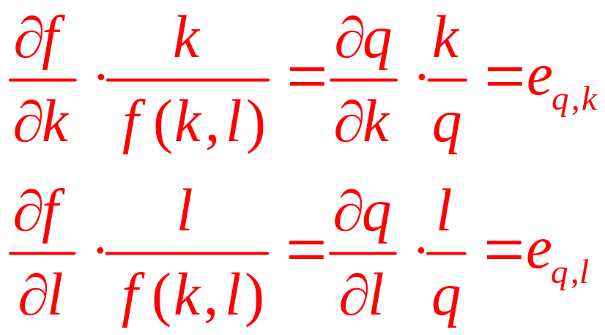
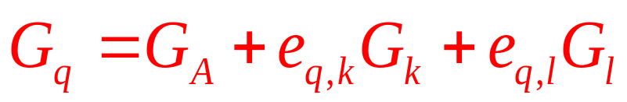
Measuring Technical Progress
Since
Growth equation:

Slide 49
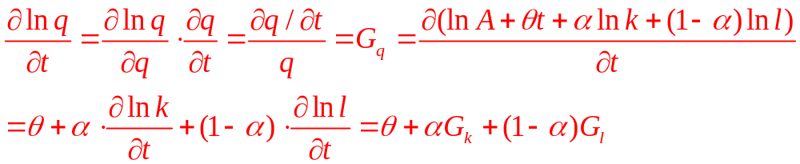
9.4 Technical Progress in the Cobb–Douglas Production Function
Production function, q = A(t)f(k,l) = A(t)k ^{α}l ^{1-α}
  Assume that technical progress occurs at a constant exponential (θ) , A(t) = Ae^{θt}
q = Ae^{θt}k ^{α}l ^{1-α}
  Taking logarithms and differentiating with respect to t gives the growth equation

Slide 50
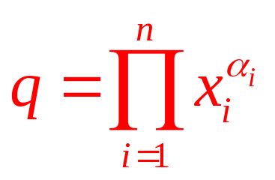
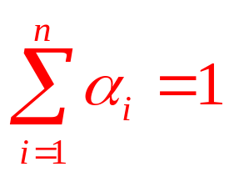
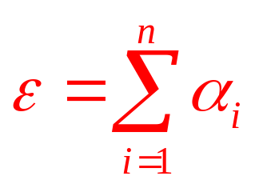
Many-input production functions
Many-input Cobb–Douglas:
  Constant returns to scale if
    α_{i} is the elasticity of q with respect to input x_{i}.
    Because 0 < α_{i} < 1, each input exhibits diminishing marginal productivity
  Any degree of increasing returns to scale can be incorporated, depending on
  The elasticity of substitution between any two inputs is 1

Slide 51
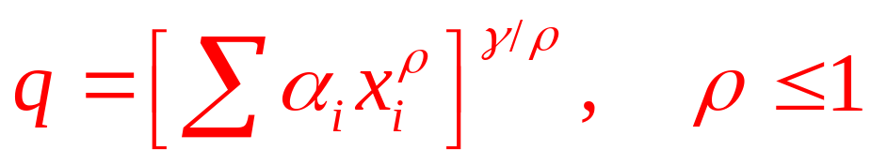
Many-input production functions
Many-input constant elasticity of substitution (CES):
  Constant returns to scale for γ=1
  Diminishing marginal productivities for each input because γ ≤ 1
  The elasticity of substitution: σ=1/(1-ρ)

Slide 52
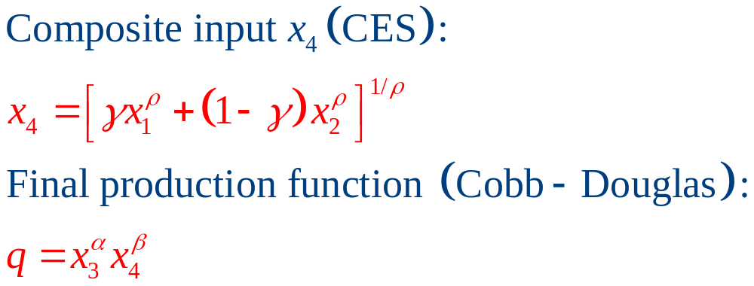
Many-input production functions
Nested production functions
  Cobb–Douglas and CES production functions are combined into a ‘‘nested’’ single function

Slide 53
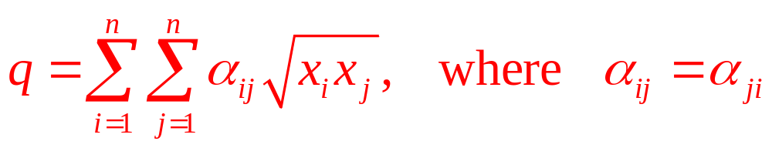
Many-input production functions
Generalized Leontief:
  Constant returns to scale
  Diminishing marginal productivities to all inputs
    Because each input appears both linearly and under the radical
  Symmetry of the second-order partial derivatives

Slide 54
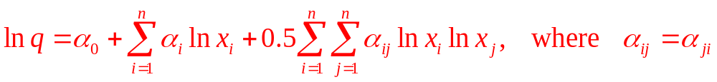
Many-input production functions
Translog:
  Cobb-Douglas for α₀ = α_{ij} = 0 for all i,j
  May assume any degree of returns to scale
  The condition α_{ij} = α_{ji} is required to ensure equality of the cross-partial derivatives

